Slide 1
PRUDENTIAL & DIGITS NETWORK
By,
ANUSHA JAIN
ABHINAV TIWARI
PRASHANT SAWALE

Slide 2
OBJECTIVE
Part 1
To analyze the Prudential Life Insurance dataset and predict the data points in the existing evaluation and sanction the outcomes to significantly amalgamate the process by building the Artificial Neural Network to conclude the results.
Part 2
To analyze scanned 1593 handwritten digits from around 80 people in the form of a gray scale of 256 values and prepare the model using Convolutional Neural Network to increase the accuracy of classification of each digit in the dataset

Slide 3
APPROACH
Part 1:
Built a Artificial Neural Network for Prudential Life Insurance by evaluating the risk factor associated with various parameters in an application to accurately classify risk on a scale of 1-8 (8 being the highest) using a more automated approach.
Part 2:
Built a Convolutional Neural Network with two Convolution and two fully connected layers to accurately classify the digits by using max-pooling and activation function

Slide 4
Part 1 Prudential Dataset Analysis Using Artificial Neural Network

Slide 5
DATA PREPARATION RECAP
Missing values
Categorical variables
Outliers removal
nearZeroVariance removal
Feature Selection by using StepAIC function and p-values obtained by linear regression

Slide 6
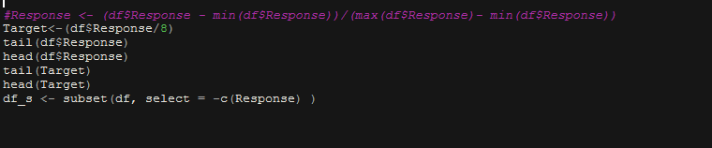
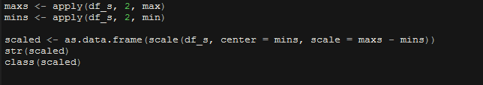
Scaling the dataset

Slide 7
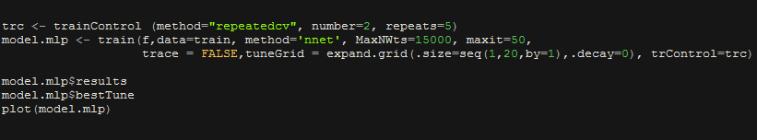
CROSS VALIDATION TO GET THE SIZE NEURONS

Slide 8
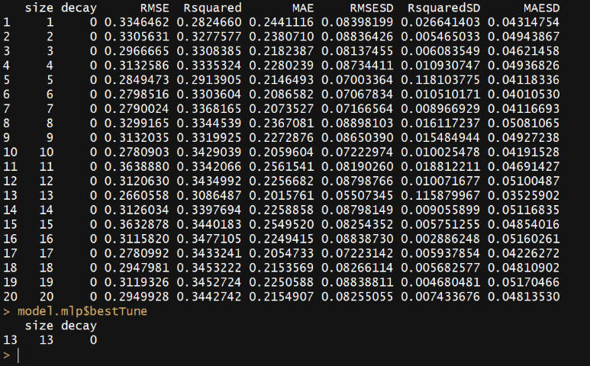
CROSS VALIDATION TO GET THE SIZE NEURONS

Slide 9
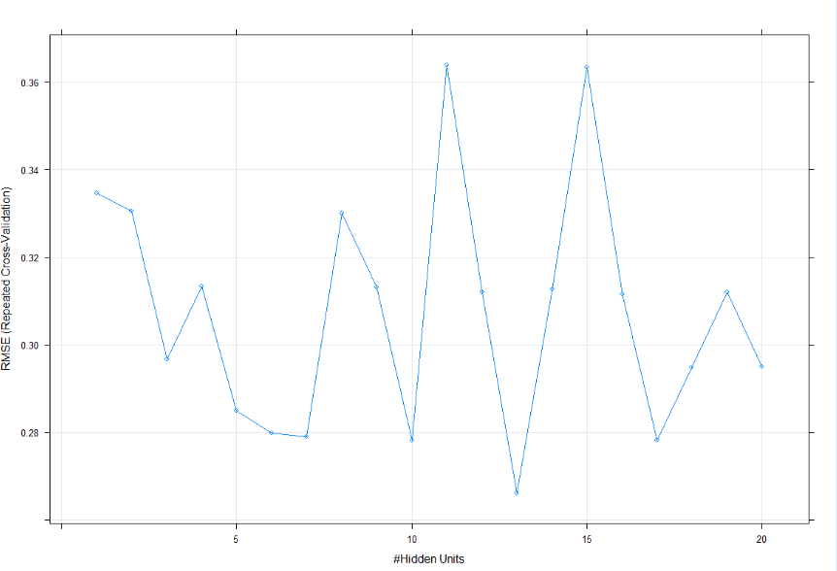
CROSS VALIDATION TO GET THE SIZE NEURONS

Slide 10
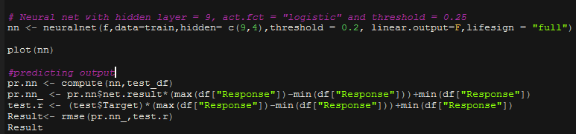
TRAINING USING DEFAULT VARIABLES

Slide 11
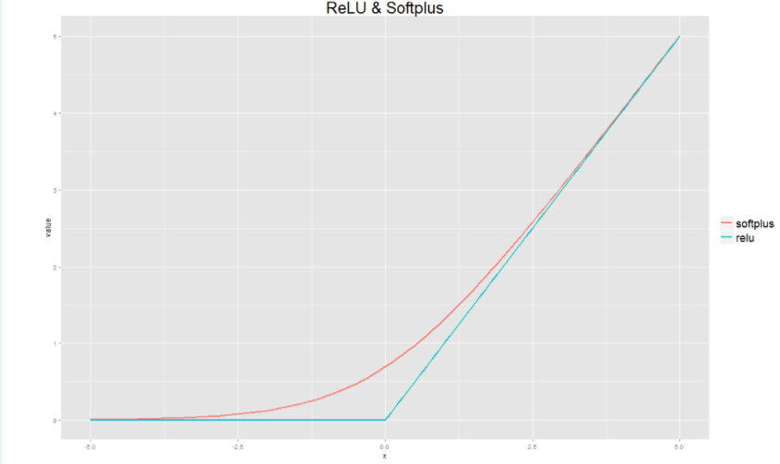
NEURAL NET WITH CUSTOM RELU(SOFTPLUS) ACTIVATION FUNCTION

Slide 12
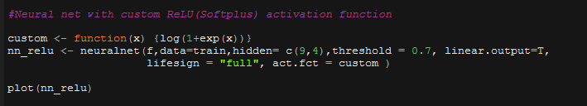
NEURAL NET WITH CUSTOM RELU(SOFTPLUS) ACTIVATION FUNCTION

Slide 13
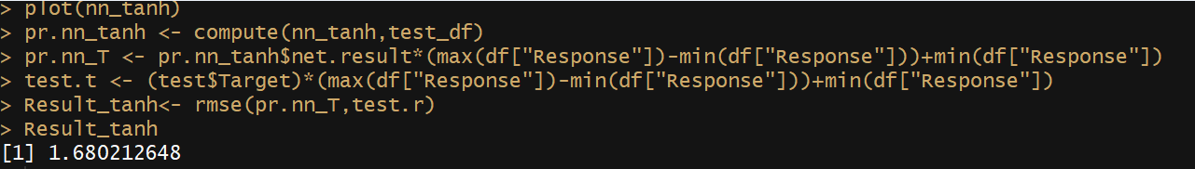
TRAINING USING TANH

Slide 14
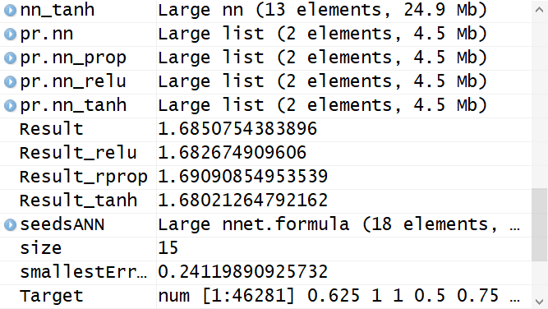
Report of the models used

Slide 15
Part 2 Digits Classification using Convolutional Neural Network
Convolution Normalization Pooling

Slide 16
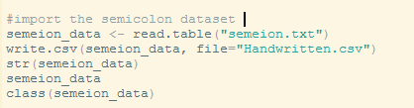
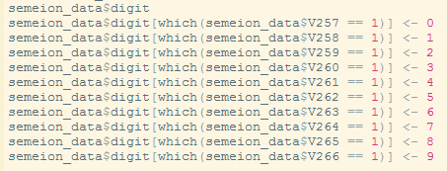
DATA PREPARATION
Imported the dataset from text and stored it in Data frame.
Inserted a Digit column representing the labels from 0 to 9

Slide 17

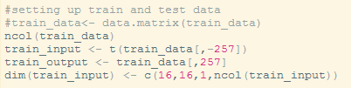
DATA PREPARATION
Divided the dataset in training an test set in the ration of 8:2
Checking distribution and frequency of each digit in both sets
Setting up Train and Test data

Slide 18
CONVOLUTION LAYER
In this layer we Convolve the image with set of filters and create stack of filtered images
As the filter is sliding, or convolving, around the input image, we find different values which tell us that how well that filter matches at certain position
conv1 <- mx.symbol.Convolution(data=data, kernel=c(3,3), num_filter=10)
Out of the available activation functions like Relu, tanh, sigmoid we used tanh function to obtain optimum results which converts the weights in the range of -1 to +1
tanh2 <- mx.symbol.Activation(data=conv2, act_type="tanh")

Slide 19
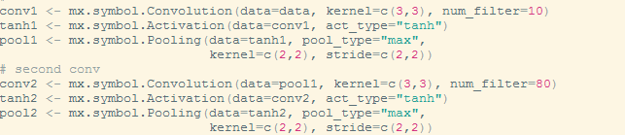
Pooling
In pooling we shrinked the image stack we generated in convolutional layer using max-pooling
Selected the stride as 2 * 2, Selected the window size as 2 * 2
Deep Stacked the layers to obtain more filtered and shrinked image in each set of layer where output of one layer is an input to the next layer

Slide 20
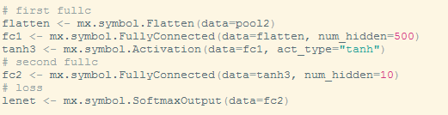
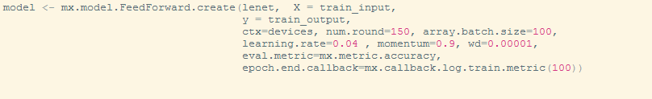
FULLY CONNECTED LAYER AND MODEL TRAINING
Fully Connected layer and Loss Function
Model Training using MxNet

Slide 21
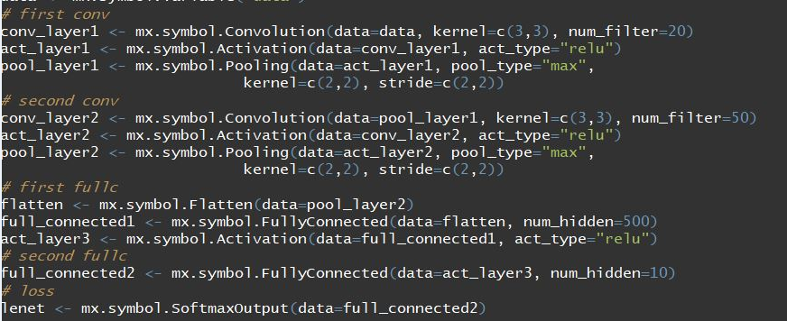
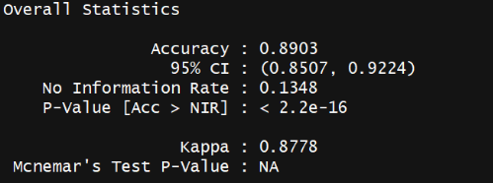
Using Relu

Slide 22
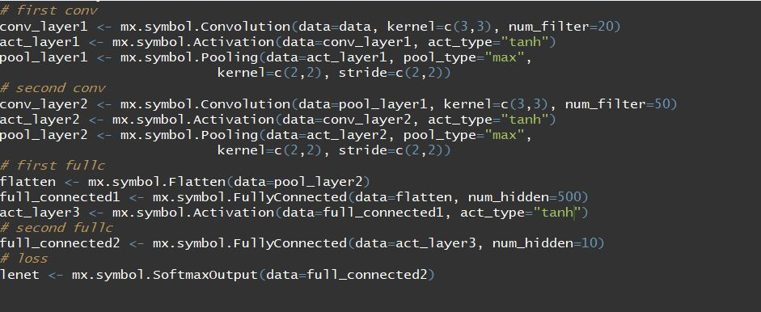
Using Tanh

Slide 23
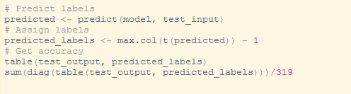
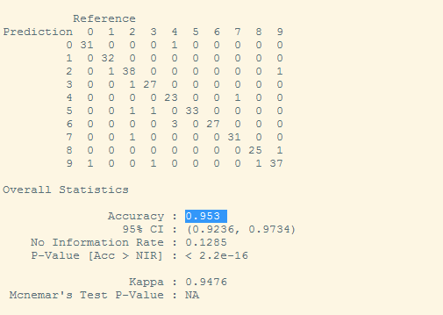
USING TANH
Prediction
Accuracy

Slide 24
Conclusion
Artificial Neural Network
RMSE = 1.680
Convolutional Neural Network
Tanh is efficient Activation function for the dataset
Relu (Rectified Linear Unit) : Accuracy = 89 %
Tanh : Accuracy = 95 %

Slide 25
Future work/recommendations
Part1
We could work on a bigger data set to scale our results and improve accuracy of the predictions in future.
This in turn could be used by various companies to target customer-centric outcomes.
Part 2
We can use a GPU for faster computing and cross validation of the dataset

